Slide 1
UTA Housing App
Nikhil Joshi
Jayant Tripathi
- Rahul Singh
- Shravan Kokkula

Slide 2
Agenda
Provide a high-level introduction to the application.
Describe key features of the application.
Demonstrate the user interface via mock screenshots
Discuss the future enhancements

Slide 3
Introduction
Currently, UTA provides an online portal for on-campus housing registration.
To bridge the gaps identified on the portal, the following features will be incorporated into the application:
Mobile-friendly version.
Provision to check the waitlisted status online.
Display the apartment rents along with their corresponding floor-plans based on the user’s selection.
Display user-reviews and ratings for each apartment.
The ‘UTA Housing App’ aims to simplify the registration process for the users so that they can make an informed decision while opting for apartments.

Slide 4
Key Features
A simple mobile-friendly interface.
Apply for housing directly through the app.
Check application status & the waitlist number, if any.
View apartment rates and floor plans within the app.
Display user-reviews and ratings for the apartments.

Slide 5
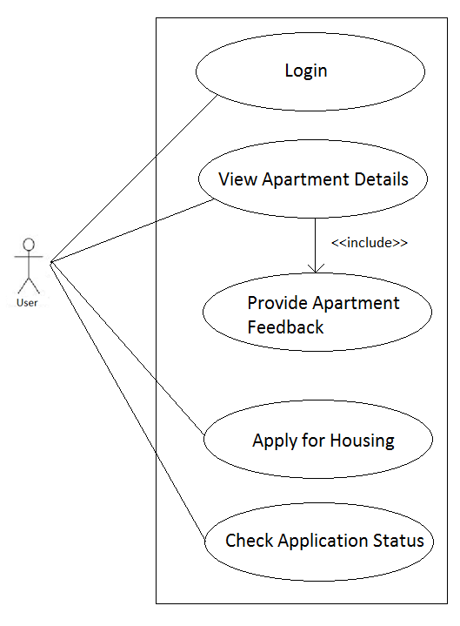
Use Case Diagram

Slide 6
User Interface

Slide 7
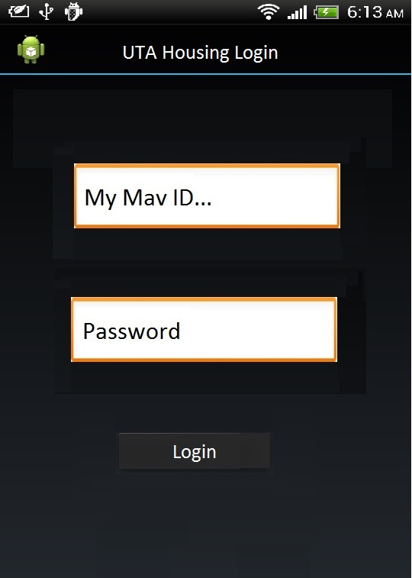
Login Page
A user will enter his/her MyMav credentials to login to the housing application.

Slide 8
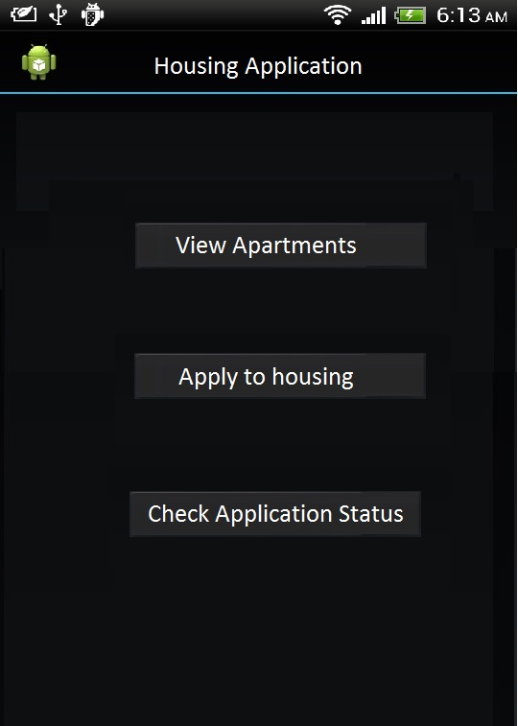
Housing Application Page
Post-login, the user can perform the following actions:
Browse through all the on-campus apartments.
Make an application for on-campus housing.
Check the waitlist status, if already applied and have been waitlisted.

Slide 9
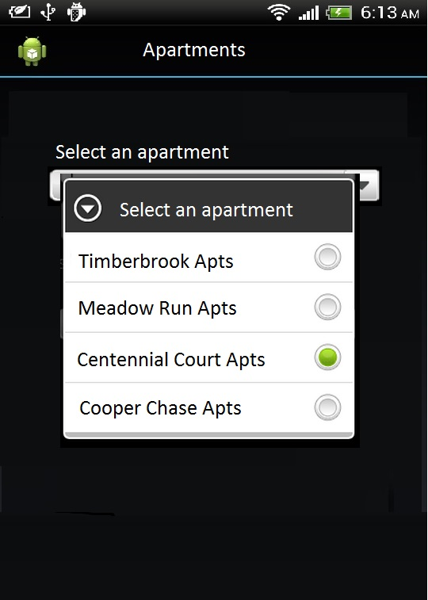
Apartments Listing & Reviews
On the apartments page, the user can select an apartment from the list after which the user will be redirected to the apartment-specific page.
The apartment page will contain the details of the various floor-plans with their corresponding rents.
The page will also display reviews and overall rating of the apartment based on feedback from various users.
A user can also provide his/her own review for the apartment.

Slide 10
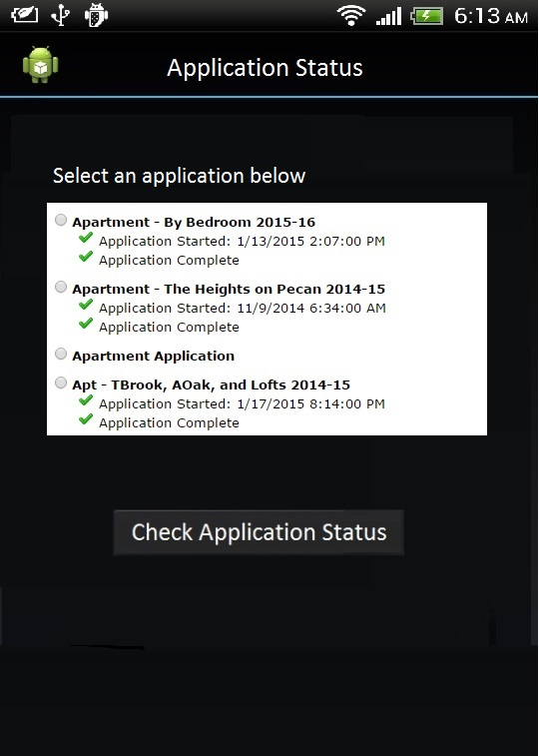
Waitlist Status check
On this page, all the applications made the user will be displayed.
A user can select an application from the list and check his position in the waiting list.

Slide 11
Technology
Platform: Android 4.x +
IDE: Eclipse
Database: SQLite
Development Platform: Windows 8.1

Slide 12
Competitors & Risks
Close Competitor Apps:
UTA Student Assist
Risks:
Time constraints

Slide 13
Future Enhancements
Connect to the live UTA servers.
Include provisions to pay the deposit & rent via the app.
Push notifications regarding Maintenance checks, Inspection schedule etc.
Suggest roommates based on user preferences.

Slide 14
Thank You

